Slide 1
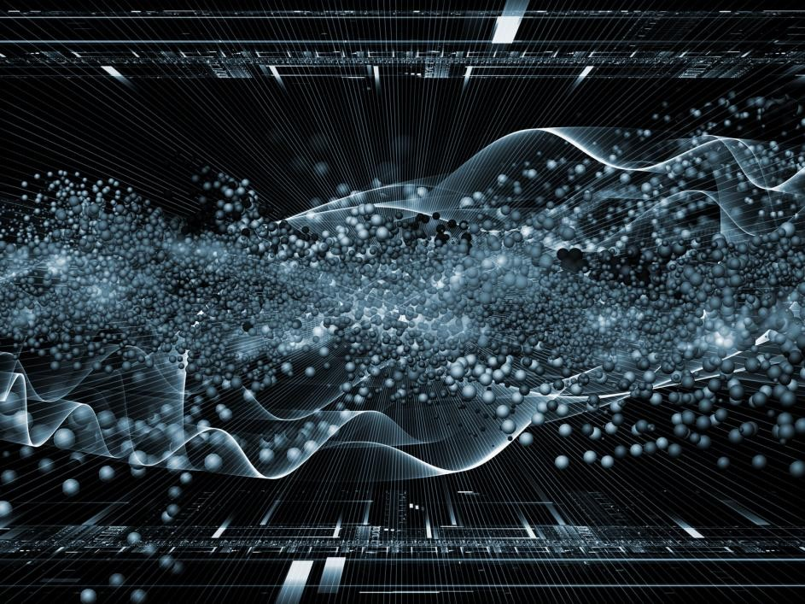
Demystifying AI What You Need to Know to Get Ahead of the Market Trends
Nigel Parker
Chief Engineer, Microsoft Commercial Software Engineering Asia
@nzigel

Slide 2
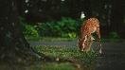
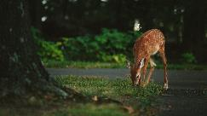
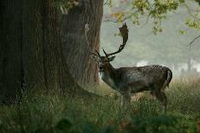
Computer Vision Tasks
Image Classification
Is there a deer in the image?
Object Detection
Where in the image is the deer?
Image Segmentation
Where exactly is the deer? What pixels?
Image Similarity
Which images are similar to the query image?
Yes
Query image
Similar image
Notes:
Computer Vision isn’t new I studied it at University

Slide 3
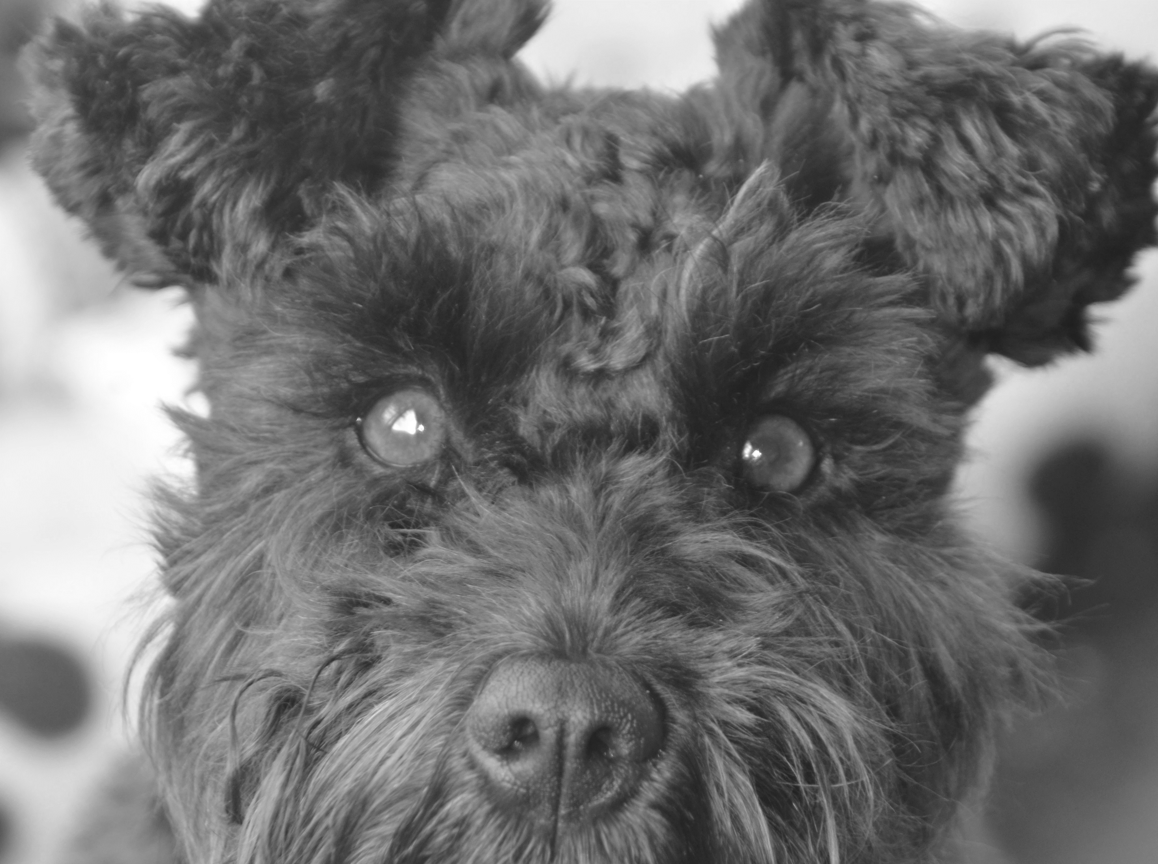
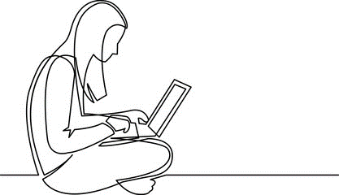
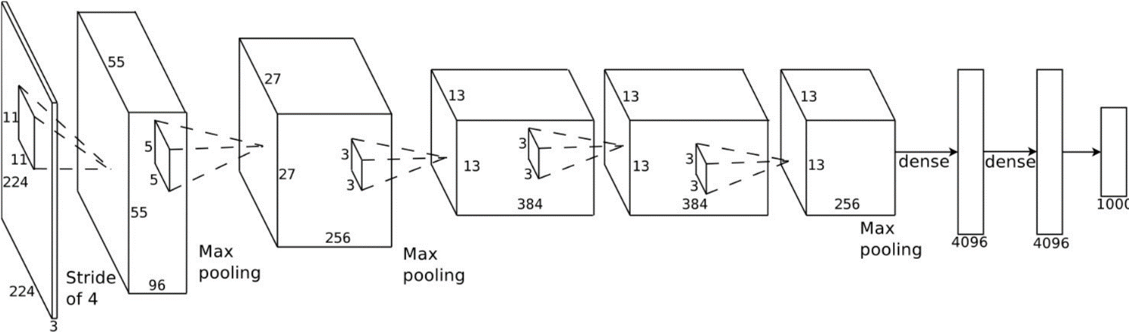
Machine Learning
Cat? NO
Dog? YES
Car? NO
Feature Extraction
Classification
Deep Learning
Connected Layers
Convolutional Layers
Cat? NO
Dog? YES
Car? NO
Feature Extraction + Classification
Output

Slide 4
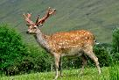
Using a Pre-Trained CNN as a Featurizer
Output Layer Stripped
Pre-Built CNN from General Task
cat? YES
dog? NO
car? NO
Generic Image Features
Outputs of penultimate layer of ImageNet Trained CNN provide excellent general purpose image features

Slide 5
Transfer Learning
New Output Layer
Pre-Built DNN from General Task
deer?
With transfer learning an accurate model can be achieved with thousands (or less) of labeled examples instead of millions
Train one or more layers in new network

Slide 6
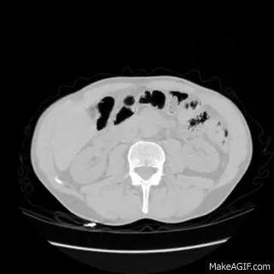
Kaggle Data Science Bowl 2017
Determine whether a patient has lung cancer

Slide 7
Solution Pieces
Data Science VM (GPU)
Microsoft Cognitive Toolkit (CNTK)
LightGBM for classification
Deep Neural Network

Slide 8
AlexNet, 8 layers
(ILSVRC 2012)
VGG, 19 layers
(ILSVRC 2014)
GoogleNet, 22 layers
(ILSVRC 2014)
ILSVRC (ImageNet Large Scale Visual Recognition Challenge)

Slide 9
ResNet, 152 layers
Microsoft

Slide 10
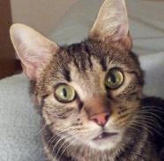
Solution: Transfer Learning
ImageNet ResNet N layers
penultimate
layer
last
layer
224
tabby
cat
224
3

Slide 11
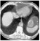
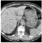
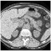
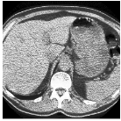

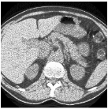

Solution: Transfer Learning
CNTK
(53min)
LightGBM
(2min)
k batch
of images
= 1 patient
penultimate
layer
224
features
no
cancer
224
3
Boosted tree
ResNet N-1 layers

Slide 12
Common Deep Neural Networks
Deep Convolutional Neural Network (DCNN)
Computer Vision
Recurrent Neural Network (RNN)
Natural Language Processing
Deep Belief Neural Network (DBNN)
Speech and Music
Deep Reinforcement Learning (DQN)
How agents should act to maximize reward (Gaming)
Notes:
Computer Vision isn’t new I studied it at University

Slide 13
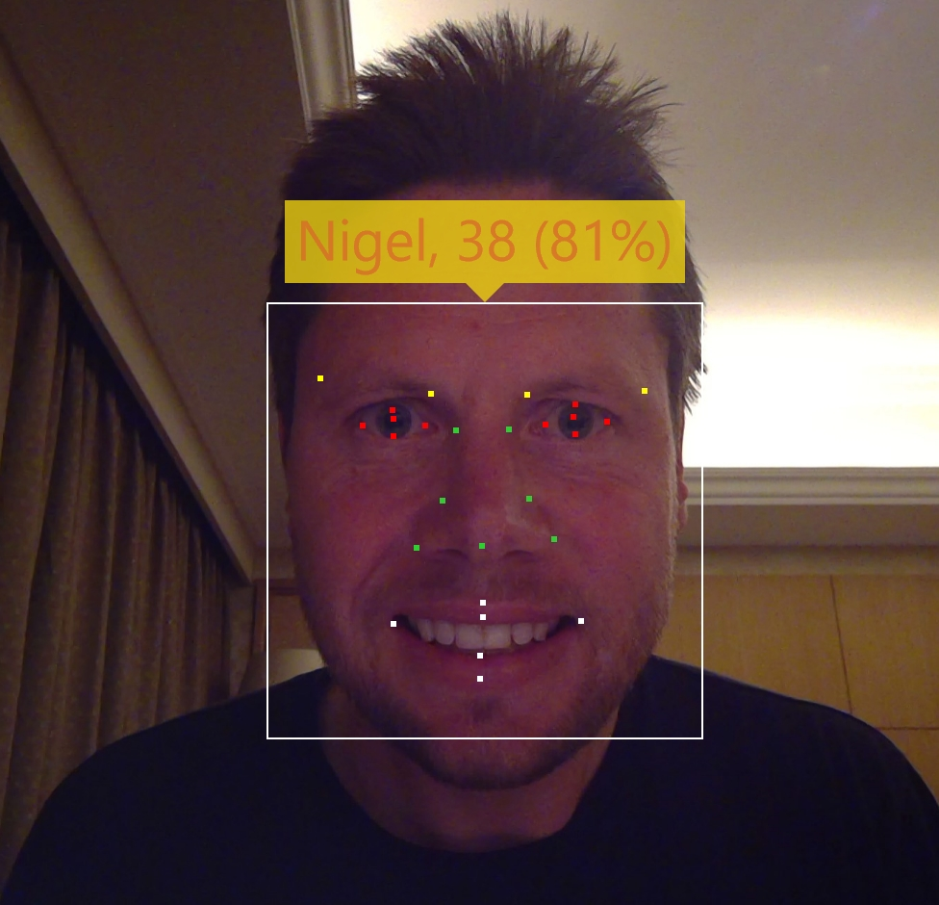
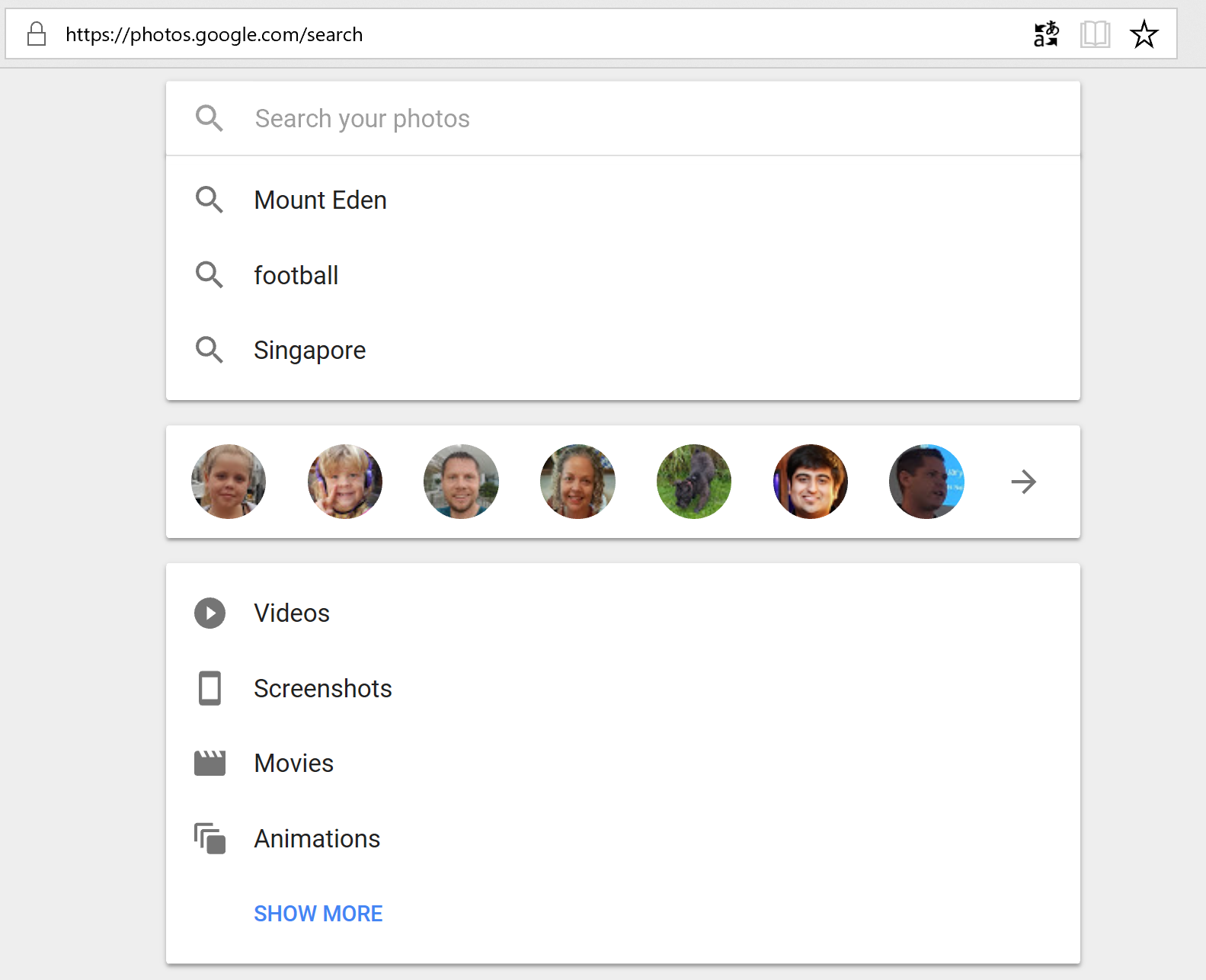
Supervised CNNs are everywhere

Slide 14




What is it?
Custom Vision Service is an easy-to-use tool for prototyping, improving, and deploying a custom image classifier to a cloud service, without any background in computer vision or deep learning required.
“cat”
Custom Vision
Model
“dog”
“dog”

Slide 15
The Microsoft AI platform: Azure+AI Cloud-powered AI for every developer
Services
CONVERSATIONAL AI
TRAINED SERVICES
CUSTOM SERVICES
CODING & MANAGEMENT TOOLS
Bot Framework
Tools
Cognitive Services
Azure Machine Learning
VS Tools for AI
Azure ML Studio
Azure ML Workbench
Others (PyCharm, Jupyter Notebooks…)
Infrastructure
DEEP LEARNING FRAMEWORKS
AI ON DATA
AI COMPUTE
3rd Party
Cosmos DB
SQL
DB
SQL
DW
Data Lake
Spark
DSVM
Batch AI
ACS
Edge
Cognitive Toolkit
TensorFlow
Caffe
CPU, FPGA, GPU
Others (Scikit-learn, MXNet, Keras, Chainer, Gluon…)

Slide 16
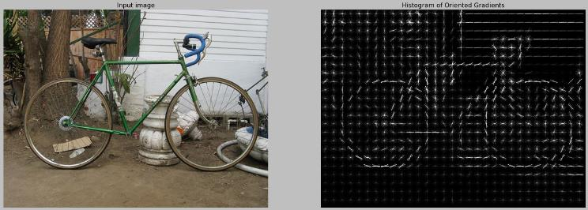
Before Deep Learning
Researchers took a traditional machine learning approach
Manual creation of a variety of different visual feature extractors
Followed by traditional Machine Learning classifiers
Example: HoG Detectors
Histogram of oriented gradients (HoG) features
Sliding window detector
SVM Classifier
Very fast OpenCV implementation (<100ms)

Slide 17
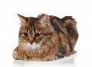


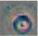
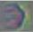
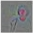
Deep Neural Network for Computer Vision
Fully Connected Layers
Convolutional Layers
cat? YES
dog? NO
car? NO
Low-Level Features (lines, edges, color fields, etc.)
High-Level Features (corners, contours, simple shapes)
Object Parts (wheels, faces, windows, etc.)
Complex Objects & Scenes (people, animals, cars, beach scene, etc.)
Image

